Slide 1

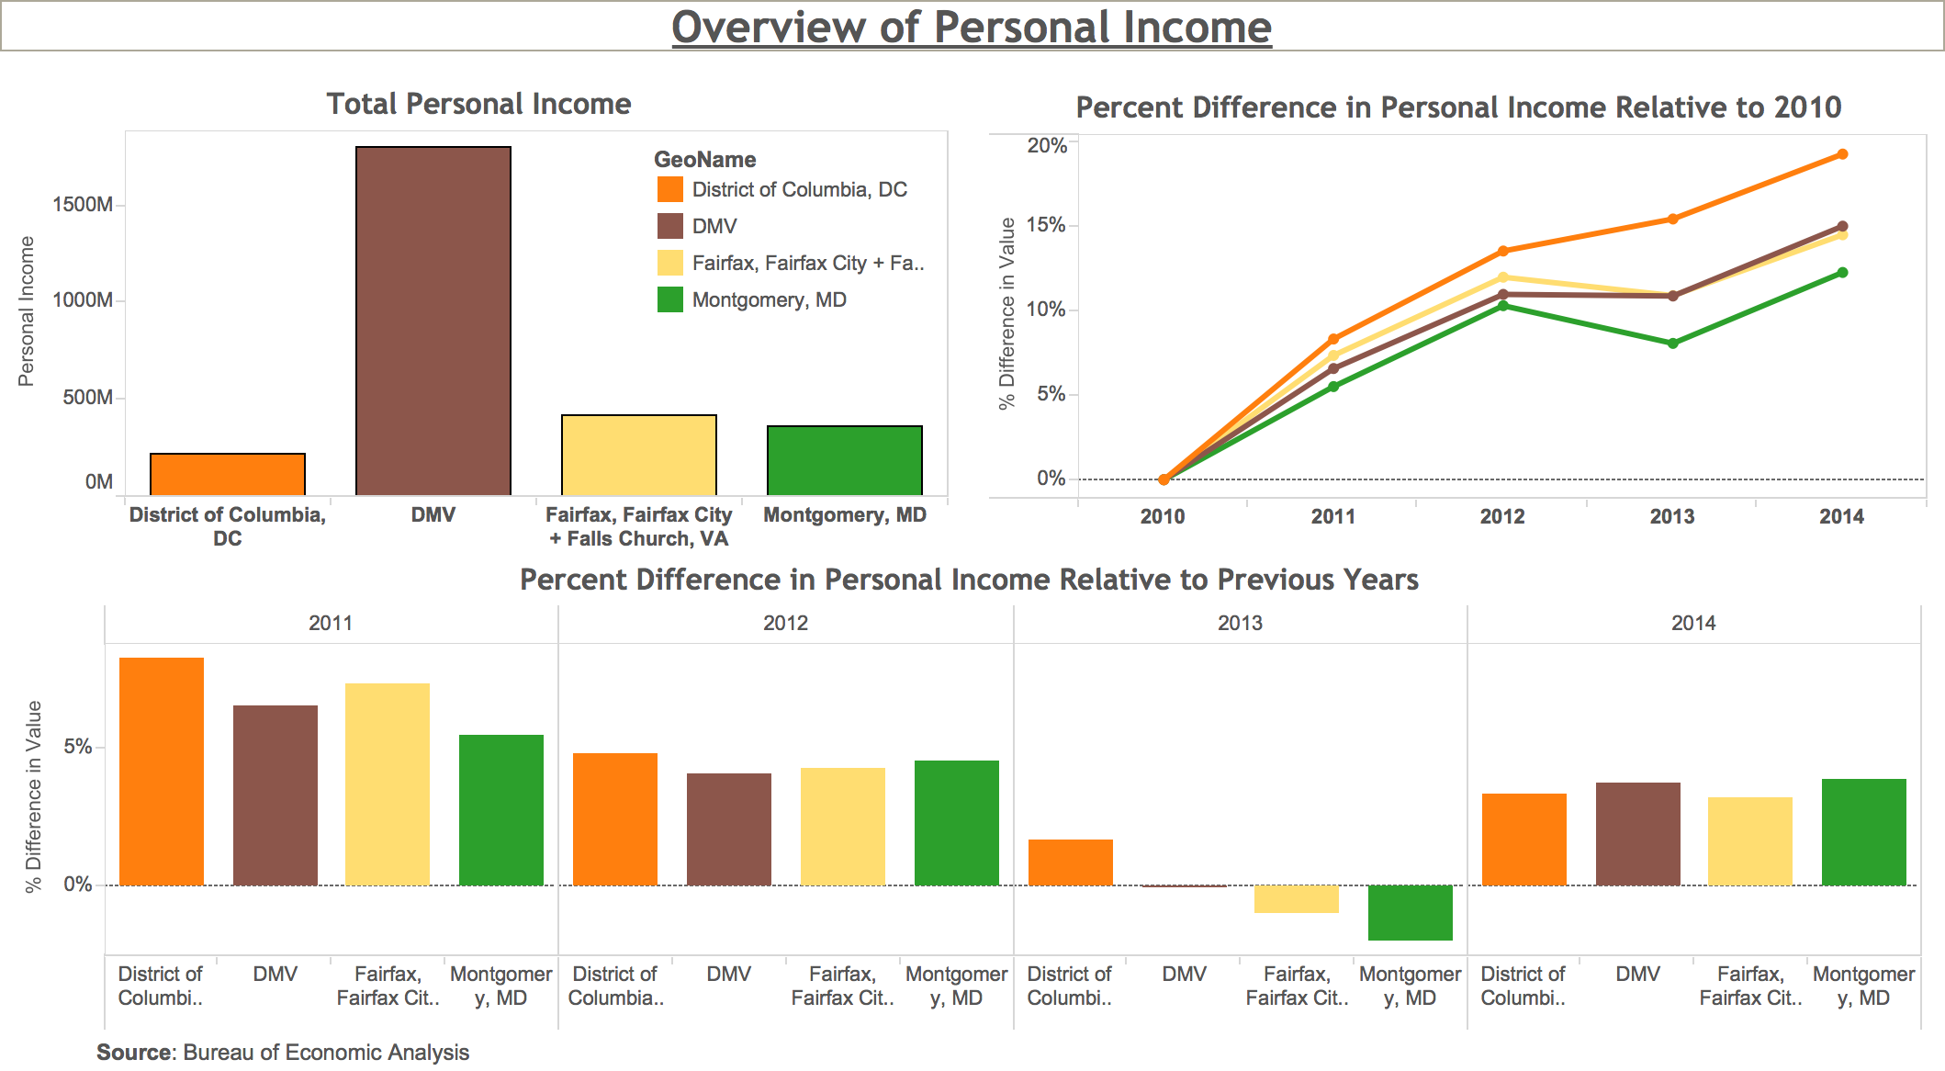
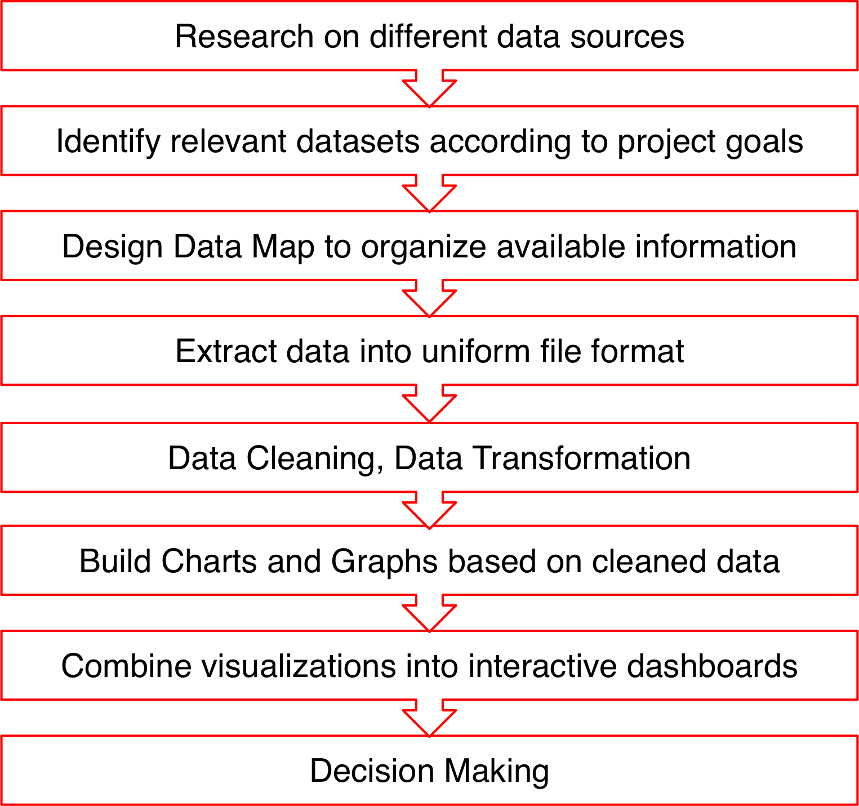
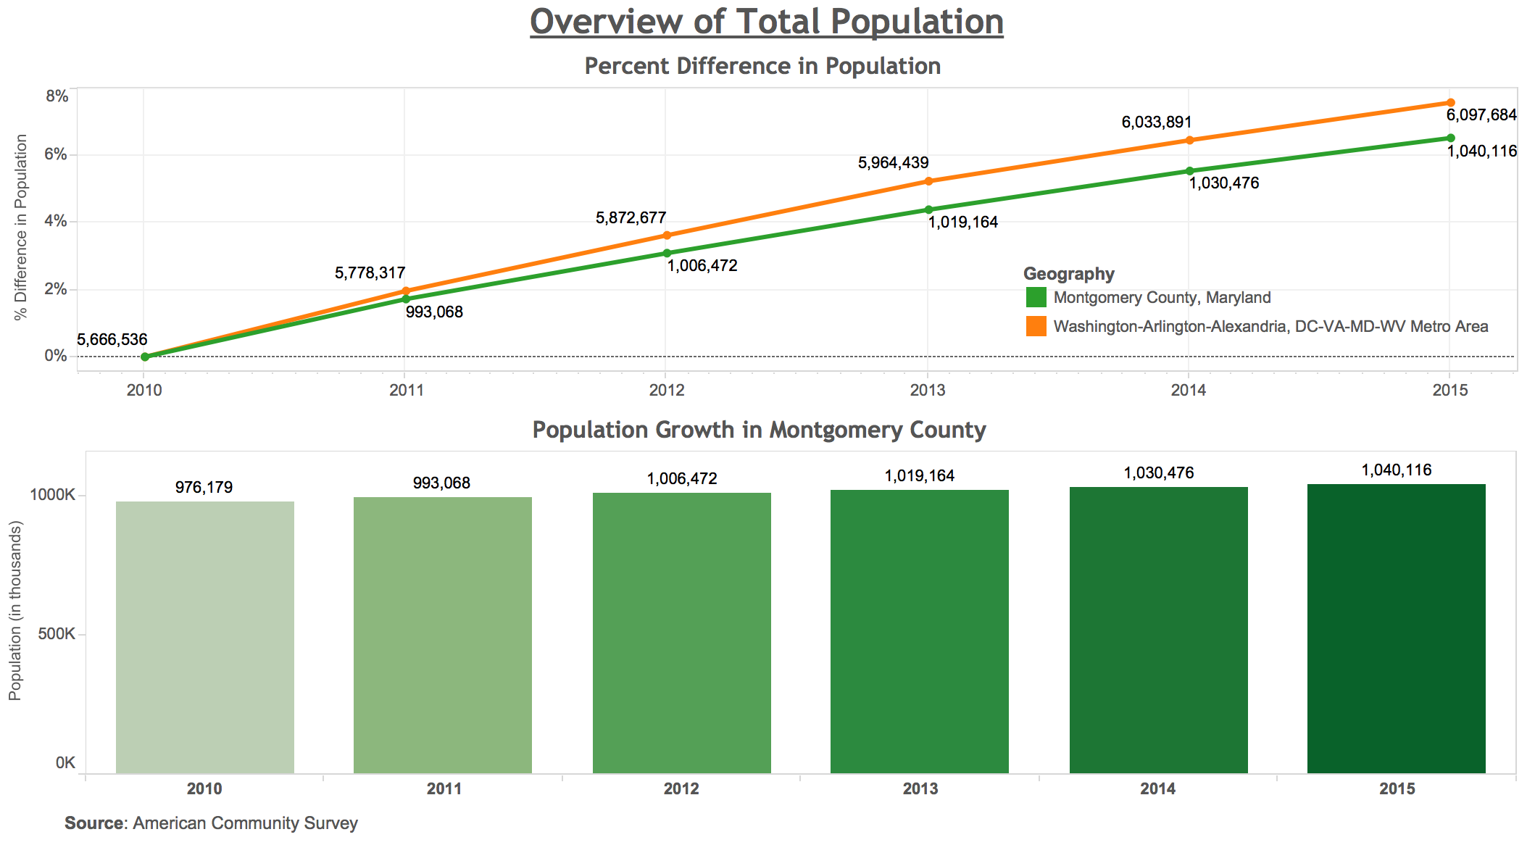
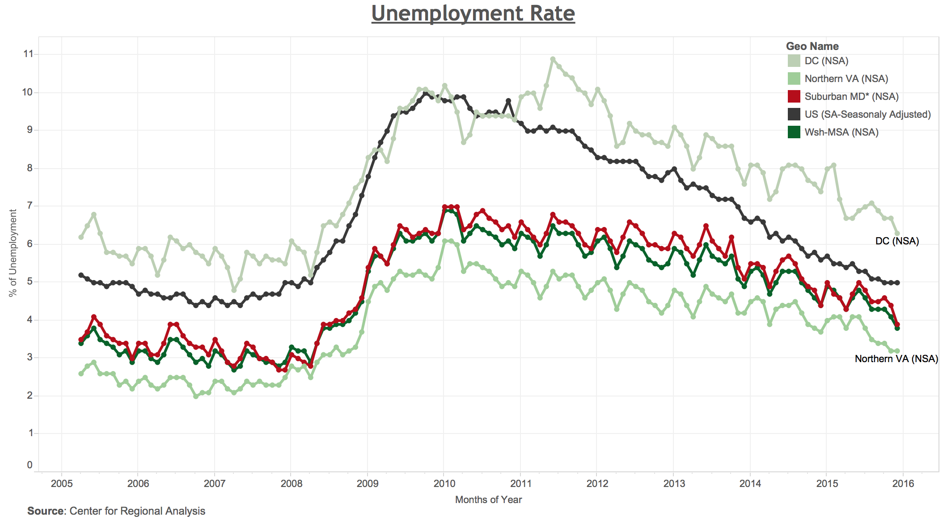
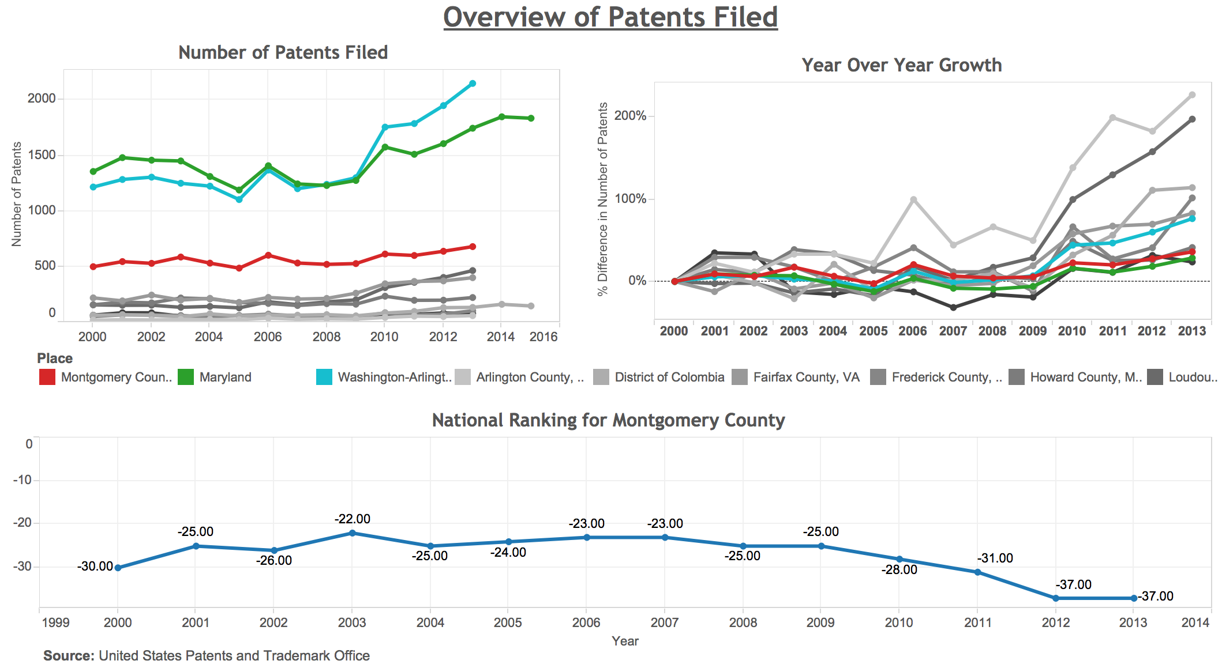

Data Visualization Using Open Data
Economic Intelligence Dashboard
Consultant: Akshay Mandke | Professor: Dr. Kathy Weaver
Client: Montgomery County – Office of the County Executive – CountyStat Team
Goals
Results
Data Sources
Provide a succinct overview of Montgomery County’s economic trends, business growth, and industry specialization through intuitive interactive dashboards
Translate open data into public policy insights by telling stories with data
Use data to make smarter decisions and achieve better outcomes for the residents of Montgomery County
BEA – Bureau of Economic Analysis
BLS – Bureau of Labor Statistics
CRA – Center for Regional Analysis
ACS – American Community Survey
FRED – Federal Reserve Economic Data
EMSI – Economic Modeling Specialists Intl.
USPTO – U.S. Patent and Trademark Office
Approach
Accomplishments
Designing a data map to combine data elements and metadata into a concise view
Working with variety of data sources
Understanding business knowledge of public policy and hands on experience in ETL
Building interactive visualizations
Challenges
Gathering relevant data since a lot of data sources were used as a part of this project
Cleaning semi structured data, formatting, normalization and transformations
Selection of appropriate data columns to build charts and graphs to draw insights

